Slide 1
High-resolution stratigraphy and facies architecture of the Upper Cretaceous (Cenomanian-Turonian) Eagle Ford Group, Central Texas
Fairbanks, M., Ruppel. S., & Rowe. H., (2016). High-resolution stratigraphy and facies
architecture of the Upper Cretaceous (Cenomanian–Turonian) Eagle Ford Group,
Central Texas. AAPG Bulletin ; 100 (3): 379–403.

Slide 2
Table of Contents
Introduction
Regional Geology
Study Area
Results: Facies & Stratigraphy
Cyclicity and Chemostratigraphic Analysis
Regional Correlation
Gama Ray and TOC Correlation
Discussion
Definitions

Slide 3
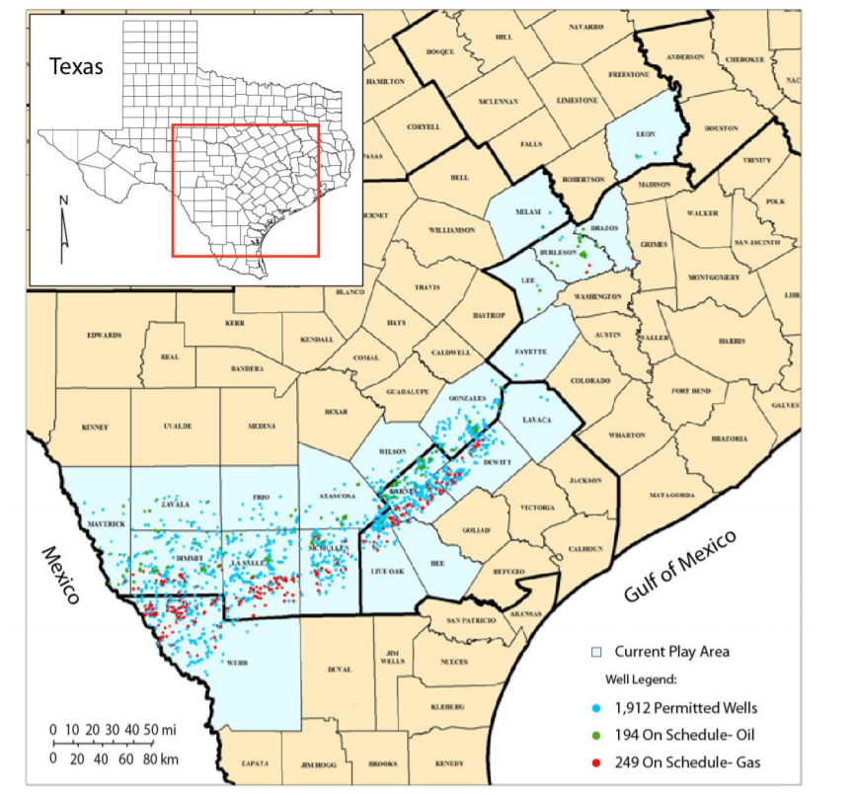
Eagle Ford Formation
Figure 1. Eagle ford Map (Harbor ,2011)
Notes:
The eagle ford formation is one of the most productive source rocks in Texas. It’s called a shale but technically it’s a mixed carbonate clastic sedimentary sequence. To goes all the way South west to the Mexico border and these are the active drilling areas as you can see in the figure.

Slide 4
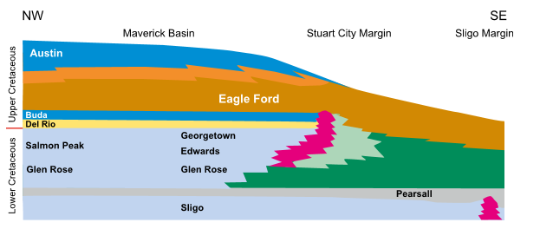
Eagle Ford Formation
Formed in middle
to late cretaceous period
Overlain by Austin chalk
Figure 2. Regional Geology map (Fairbanks, Ruppel & Rowe, 2016)

Slide 5
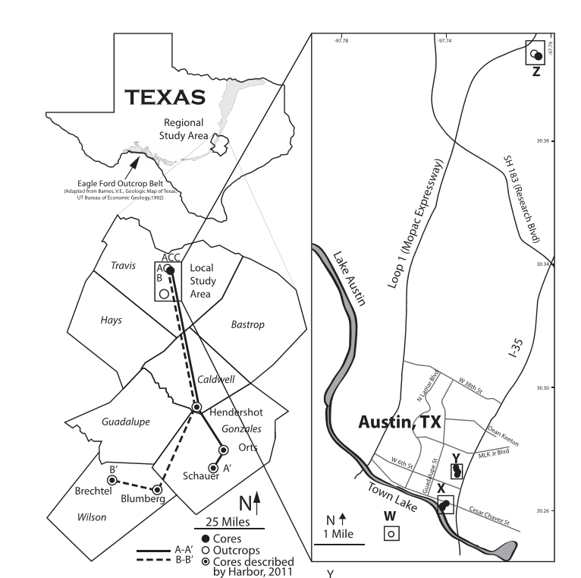
Study Area
Facies study is conducted in the Eagle ford:
To determine facies variability
To Correlate
To determine TOC to eventually optimize production
And to understand the distribution of reservoir properties
Figure 3. Study Area (Fairbanks, Ruppel & Rowe, 2016)

Slide 6
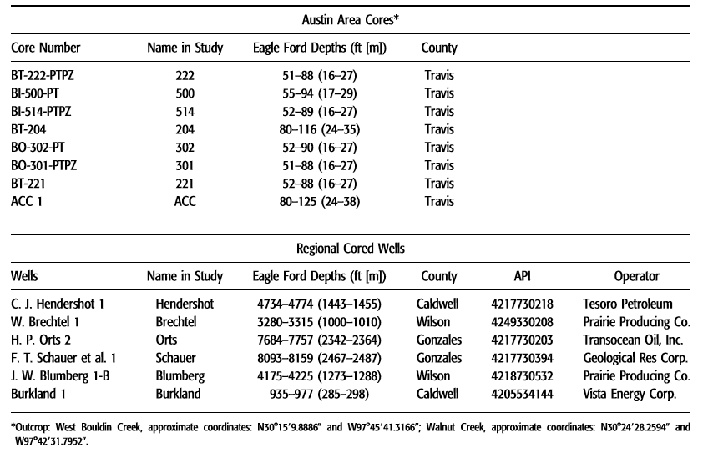
Study Area
8 cores (7 close)
2 outcrops
6 Regional Cored wells from Harbor (2011)
Core Analysis using, XRD, XFR, and logs
Table1. Data Set (Fairbanks, Ruppel & Rowe, 2016)

Slide 7
Results (facies)
(1) massive argillaceous mudrock,
(2) massive foraminiferal calcareous mudrock,
(3) laminated calcareous foraminiferal lime mudstone,
(4) laminated foraminiferal wackestone,
(5) cross-laminated foraminiferal packstone–grainstone,
(6) massive bentonitic claystone, and
(7) nodular foraminiferal packstone–grainstone.

Slide 8
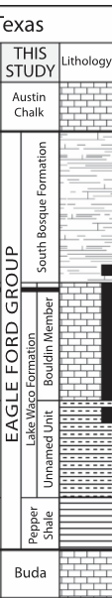
Results (facies)
Eagle ford divided into 4 units
1. Pepper shale
2. Unnamed unit
3. Bouldin Member
4. South Bosque Formation
Figure 4. Stratigraphic Sequence(Fairbanks, Ruppel & Rowe, 2016)

Slide 9
Results (facies and Stratigraphy)
(1) massive argillaceous mudrock,
(2) massive foraminiferal calcareous mudrock,
(3) laminated calcareous foraminiferal lime mudstone,
(4) laminated foraminiferal wackestone,
(5) cross-laminated foraminiferal packstone–grainstone,
(6) massive bentonitic claystone, and
(7) nodular foraminiferal packstone–grainstone.
Figure 4. Stratigraphic Sequence(Fairbanks, Ruppel & Rowe, 2016)

Slide 10
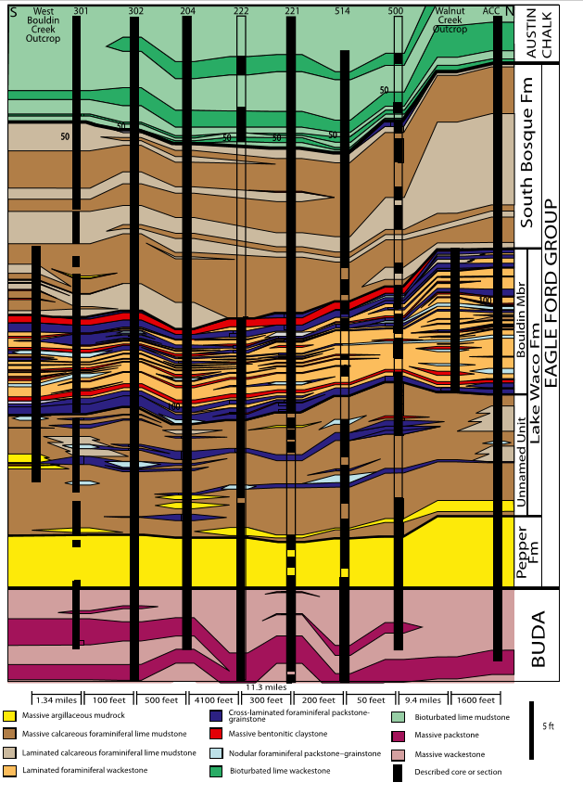
Cyclicity and Facies Continuity
Analyze continuity of facies in the cores
High degree of facies discontinuity even in close spacing
Core 514 (nodular foraminifera packstone-grainstone vs Core 500
Core204 (Argillaceous mudrock) vs Core 302
Cyclicity in Bouldin Member
Figure 5. Correlation chart(Fairbanks, Ruppel & Rowe, 2016)

Slide 11
Chemostratigraphic Analysis
Trace elements tells ocean chemistry and are used as proxies for water anoxia and are immobile
Mo (molybdenum is used for the study) because of its high enrichment in organic facies
Mo is high in anoxic marine systems and its found in high concentration in Bouldin Member of the Eagle ford.

Slide 12
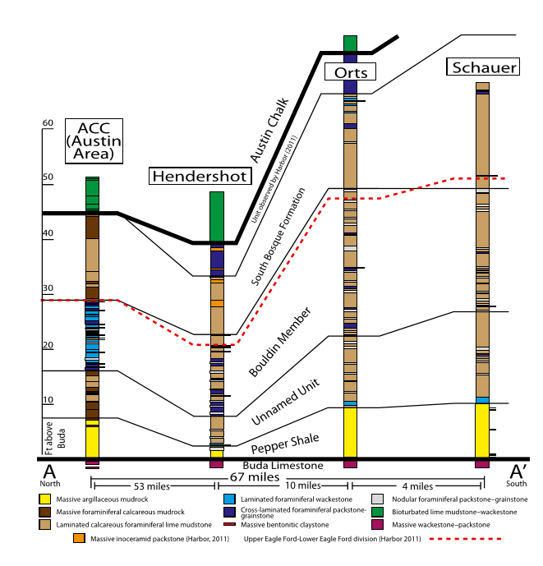
Regional cored surface wells correlation
The units thicken as we go shallow towards San Marcos arch
There is a facies change in the units
Bouldin member contains low energy facies
Reduce of planktonic activity as we go Shallow
Unconformity becomes conformity as we go towards Austin, Texas
Figure 6. Correlation chart(Fairbanks, Ruppel & Rowe, 2016)

Slide 13
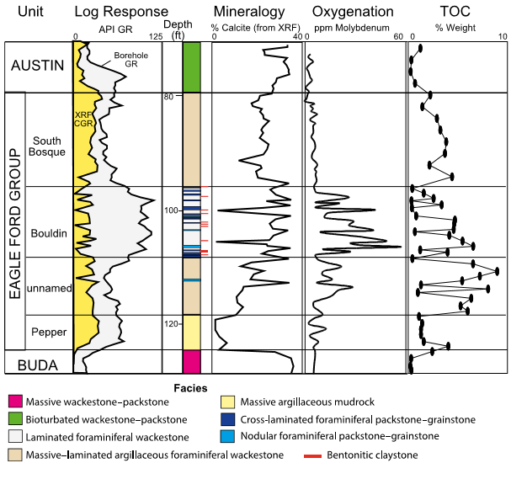
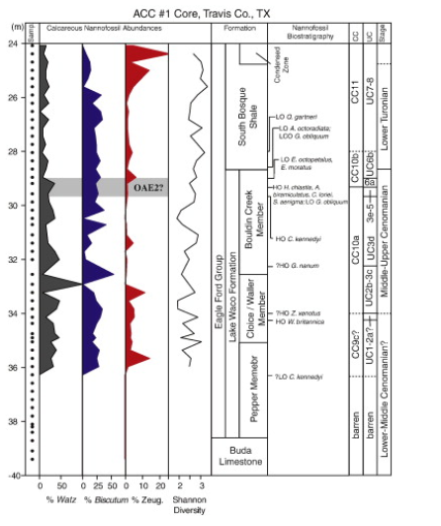
Gama Ray and TOC Correlations
Discrepancy between GR and CRG in Bouldin
TOC content high in unnamed unit
CRG tell high carbonate in Bouldin vs unnamed unit but looking at GR its incorrect
Spectral GR log are important
Figure 7. GR and TOC chart (Fairbanks, Ruppel & Rowe, 2016)
Figure 8: TOC chart in Eagle ford (Corbett &Watkins 2013)

Slide 14
Discussion:
Bouldin member has greatest degree of anoxic environment when deposited but they have high energy facies
High U content but low TOC
Study demonstrates that This is due to carbonate dilution where high supply of planktonic sediments and bottom reworking has caused increased amount of carbonate due to which TOC is only preserved a little

Slide 15
Definitions:
Thermohaline circulation (THC) is a part of the large-scale ocean circulation that is driven by global density gradients created by surface heat and freshwater fluxes.
Coriolis forces an effect whereby a mass moving in a rotating system experiences a force (the Coriolis force ) acting perpendicular to the direction of motion and to the axis of rotation
Thermohaline circulation. (2019, March 25). Retrieved from https://en.wikipedia.org/wiki/Thermohaline_circulation
Coriolis force. (2019, May 06). Retrieved from https://en.wikipedia.org/wiki/Coriolis_force

Slide 16
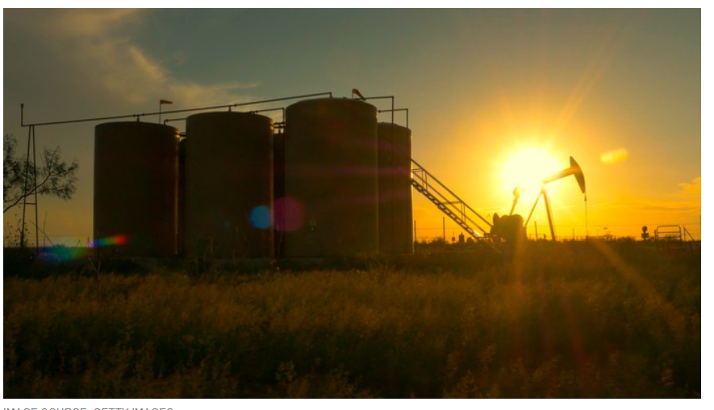
Relevance to Oil Industry
Eagle ford Shale Deflation problem
High-resolution facies studies can help find better spots to perforate and increase production
Figure 9. Facilities in Eagle ford shale(DiLallo, 2016)

Slide 17
References
Primary Paper
Fairbanks, M., Ruppel. S., & Rowe. H., (2016). High-resolution stratigraphy and facies architecture of the Upper Cretaceous (Cenomanian–Turonian) Eagle Ford Group, Central Texas. AAPG Bulletin ; 100 (3): 379–403.
Two Required Additional Refereed Journal Articles
Harbor, R. L., (2011). Facies characterization and stratigraphic architecture of organic- rich mudrocks, Upper Cretaceous Eagle Ford Formation, South Texas, M.S. thesis, The University of Texas at Austin, Austin, Texas, 184 p.
Corbett, J. M., and D. K. Watkins, (2013). Calcareous nannofossil paleoecology of the mid- Cretaceous Western Interior Seaway and evidence of oligotrphic surface waters during OAE2: Palaeogeography, Palaeoclimatology, Palaeoecology, v. 392, p. 510–523.
One Required Events Reference
DiLallo, M., (2019). Top Oil Stocks for the Coming Boom in the Eagle Ford Shale. The Motley Fool, 2019. Retrieved from https://www.fool.com/investing/2019/04/13/3-top-oil-stocks-for-the-coming-boom-in-the-eagle.aspx
Additional References DiLallo, M., (2019). Top Oil Stocks for the Coming Boom in the Eagle Ford Shale. The Motley Fool, 2019. Retrieved from https://www.fool.com/investing/2019/04/13/3-top-oil-stocks-for-the-coming-boom-in-the-eagle.aspx

Slide 18
Thank you

